Slide 1

Introduction to Data Analytics
ITE 5201
Lecture5-DataTypes and statistics

Slide 2

Data Types
Ordinal Variables
Binary data.
Discrete and continuous data.
Interval and ratio variables
Qualitative and Quantitative traits/ characteristics of data.
Copyright © 2018 Pearson Education, Inc. All Rights Reserved.

Slide 3
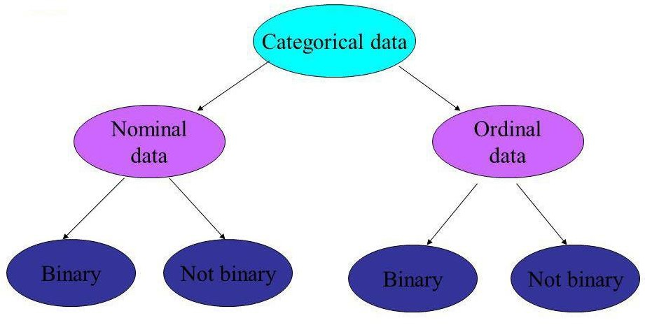
Categorical data
Copyright © 2018 Pearson Education, Inc. All Rights Reserved.

Slide 4
Nominal Data
A type of categorical data in which objects fall into unordered categories. Example:
Type of Bicycle
Mountain bike, road bike, chopper, folding,,BMX.
Ethnicity
White British, Afro-Caribbean, Asian, Chinese, other, etc. (note problems with
these categories).
Smoking status
smoker, non-smoker
Copyright © 2018 Pearson Education, Inc. All Rights Reserved.

Slide 5
Ordinal Data
A type of categorical data in which order is important.
Class of degree-1st class, 2:1, 2:2, 3rd class, fail
Degree of illness- none, mild, moderate, acute, chronic.
Opinion of students about stats classes-Very unhappy, unhappy, neutral, happy, ecstatic!
Copyright © 2018 Pearson Education, Inc. All Rights Reserved.

Slide 6
Binary Data
A type of categorical data in which there are only two categories. Binary data can either be nominal or ordinal.
Smoking status- smoker, non-smoker
Attendance- present, absent
Class of mark- pass, fail.
Status of student- undergraduate, postgraduate.
Copyright © 2018 Pearson Education, Inc. All Rights Reserved.

Slide 7
Quantity Data
The objects being studied are ‘measured’ based on some quantitative trait.
The resulting data are set of numbers.
Example:
Pulse rate
Height
Age
Exam marks
Size of bicycle frame
Time to complete a statistics test
^{➢Num}C^{ber}opyri^{of}ght^{c}©^{iga}2018^{ret}Pearso^{tes}n^{sm}Edu^{oked}cation, Inc. All Rights Reserved.

Slide 8
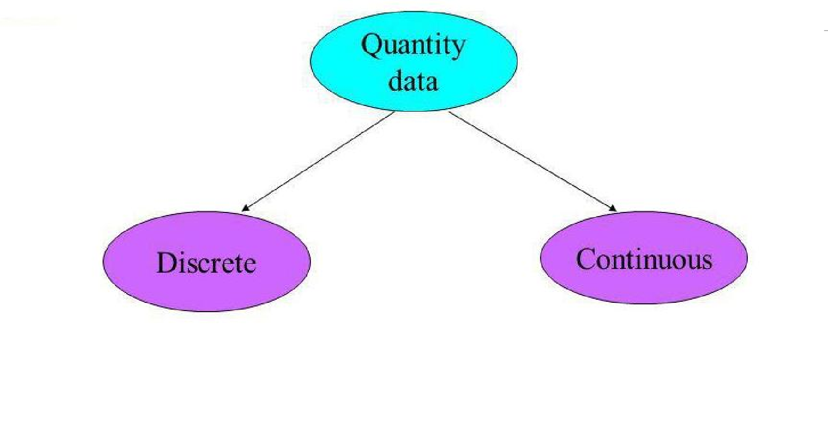
Quantity Data can be classified as Discrete or Continuous
Discrete Data
Only certain values are possible (there are gaps between the possible values).
Continuous Data
Theoretically, with a fine enough measuring device.
Copyright © 2018 Pearson Education, Inc. All Rights Reserved.

Slide 9
Examples: Discrete Data
Number of children in a family
Number of students passing a stats exam
Number of crimes reported to the police
Number of bicycles sold in a day.
Generally, discrete data are counts.
We would not expect to find 2.2 children in a family or 88.5 students passing an exam or crimes being reported to the police or half a bicycle being sold in one day.
Copyright © 2018 Pearson Education, Inc. All Rights Reserved.

Slide 10
Examples: Continuous data
Size of bicycle frame
Height
Time to run 500 meters
Age
‘Generally, continuous data come from measurements.
(any value within an interval is possible with a fine enough measuring device)
Copyright © 2018 Pearson Education, Inc. All Rights Reserved.

Slide 11
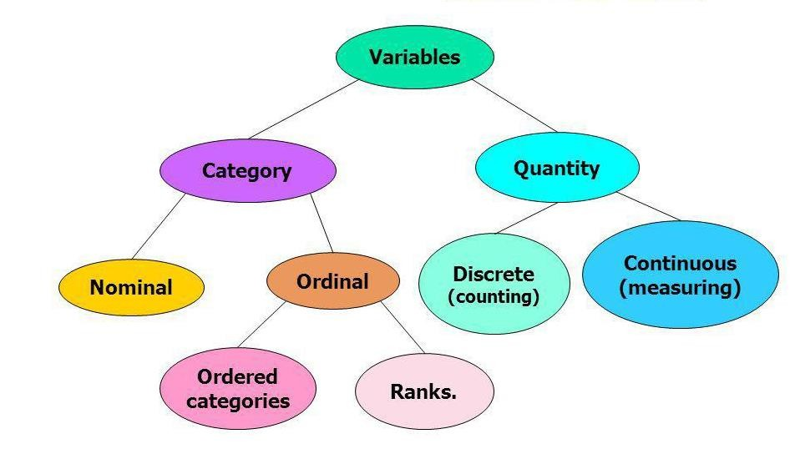
Relationships between Variables
Copyright © 2018 Pearson Education, Inc. All Rights Reserved.

Slide 12
Absolute Measure of Dispersion
An absolute measure of dispersion contains the same unit as the original data set.
Range
Variance: Standard Deviation
Quartiles and Quartile Deviation
Mean and Mean Deviation
Copyright © 2018 Pearson Education, Inc. All Rights Reserved.

Slide 13
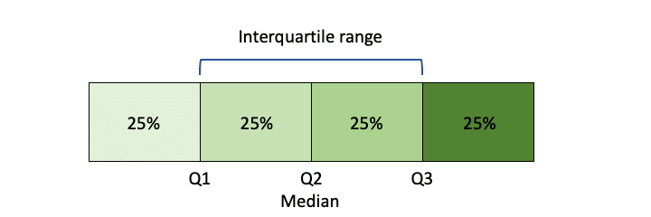
Range
It is the simplest method of measurement of dispersion.
It is defined as the difference between the largest and the smallest
item in a given distribution.
Range = Largest item (L) – Smallest item (S) Interquartile Range
It is defined as the difference between the Upper Quartile and Lower Quartile of a given distribution.
Interquartile Range = Upper Quartile (Q₃)–Lower
Quartile(Q₁)
Copyright © 2018 Pearson Education, Inc. All Rights Reserved.

Slide 14
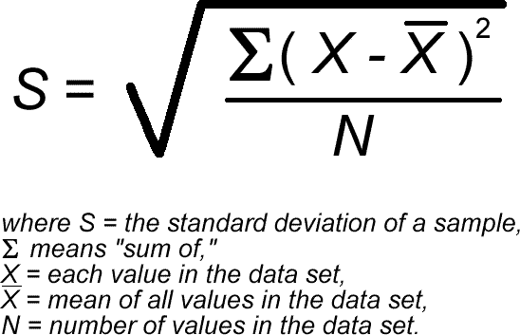
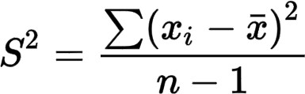
Variance and Standard Deviation
▶Variance: is a measure of how data points differ from the mean.
▶A variance is a measure of how far a set of data are spread out from their mean value.
▶Standard deviation: is a measure of variability. It defines the width of
normal distribution.
Copyright © 2018 Pearson Education, Inc. All Rights Reserved.

Slide 15
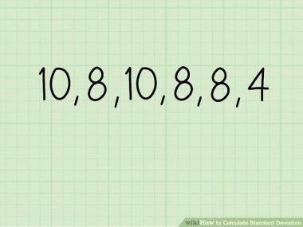
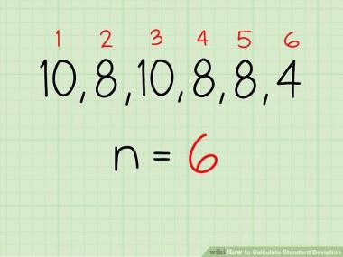
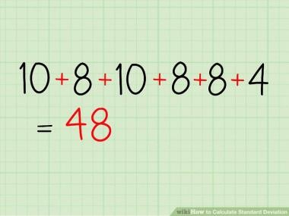
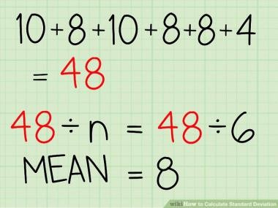

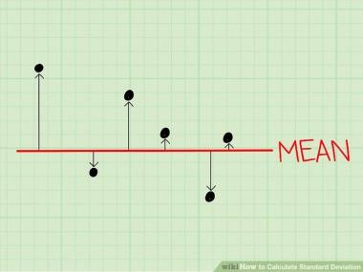
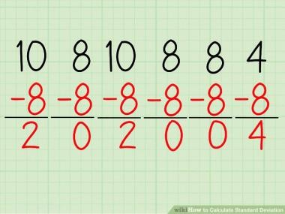
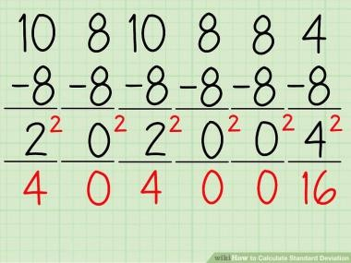
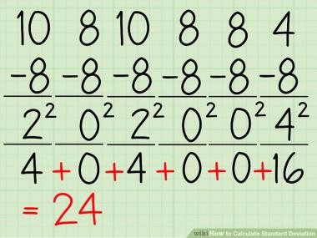
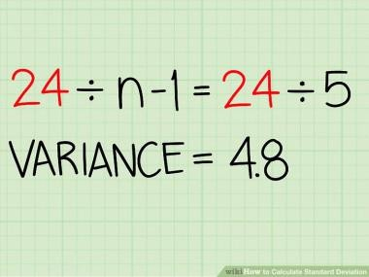
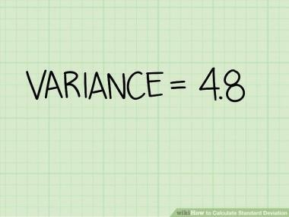
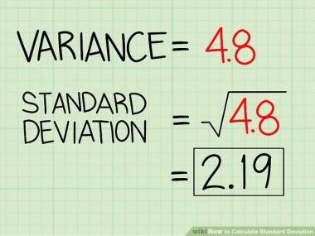
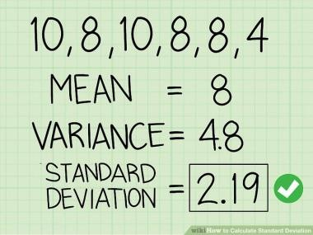
Copyright © 2018 Pearson Education, Inc. All Rights Reserved.

Slide 16
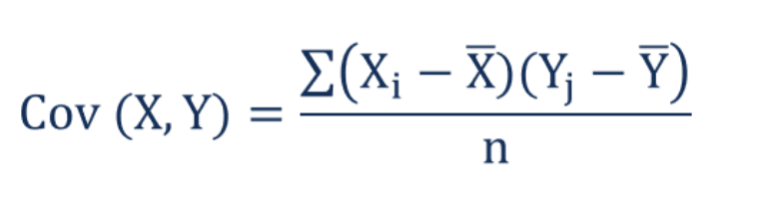
What is Covariance?
In mathematics and statistics, covariance is a measure of the relationship between two random variables. The metric evaluates how much – to what extent – the variables change together.
Positive covariance: Indicates that two variables tend to move in the same direction.
Negative covariance: Reveals that two variables tend to move in inverse directions.

Slide 17
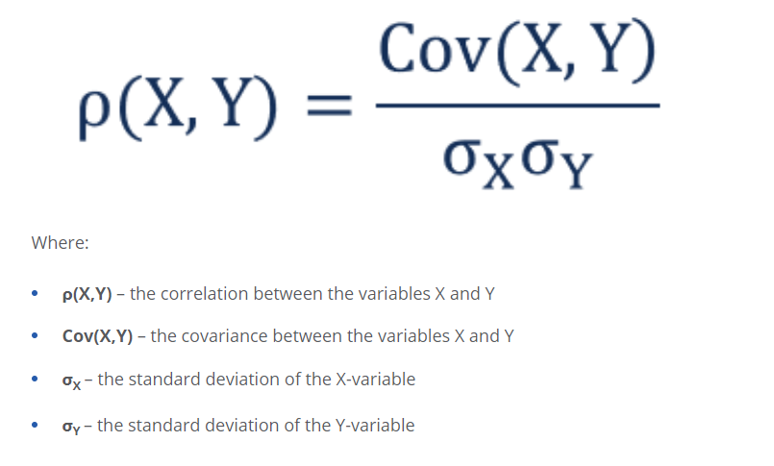
Correlation
Correlation measures the strength of the relationship between variables. Correlation is the scaled measure of covariance.

Slide 18
Measures of strength of a relationship (Correlation)
Pearson’s correlation coefficient (r)
Spearman’s rank correlation coefficient (rho, r)
Copyright © 2018 Pearson Education, Inc. All Rights Reserved.

Slide 19
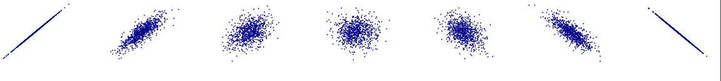
Perfect linear relationship – no error Strong linear relationship – small error
Weak linear relationship – large error No linear relationship

Slide 20
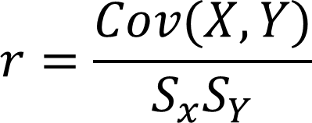
Pearsons correlation coefficient is defined as below:
∑(x_{i} − x )(y_{i} − y)
i=1
n
S
r =
xy
=
^{S}xx ^{S}yy
n
∑
i=1
(x − x )
n
∑
i=1
(y − y)
2
2
i
i
Cov= covariance
S= Standard deviation
Copyright © 2018 Pearson Education, Inc. All Rights Reserved.

Slide 21
Properties of Pearson’s correlation coefficient r
The value of r is always between –1 and +1.
If the relationship between X and Y is positive, then r will be positive.
If the relationship between X and Y is negative, then r will be negative.
If there is no relationship between X and Y, then r will be zero.
The value of r will be +1 if the points, (x_{i}, y_{i}) lie on a straight line with positive slope.
The value of r will be +1 if the points, (x_{i}, y_{i}) lie on a straight line with positive slope.
Copyright © 2018 Pearson Education, Inc. All Rights Reserved.

Slide 22
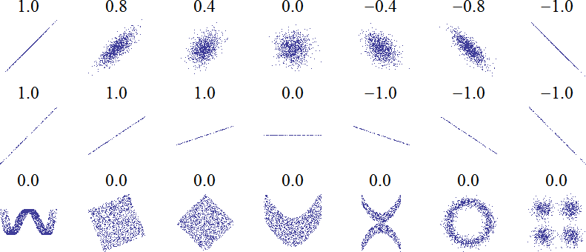

Slide 23
Spearman’s rank correlation coefficient ρ (rho)
Copyright © 2018 Pearson Education, Inc. All Rights Reserved.

Slide 24
Spearman’s rank correlation coefficient r (rho)
Spearman’s rank correlation coefficient is computed as follows:
Arrange the observations on X in increasing order and assign them the
ranks 1, 2, 3, …, n
Arrange the observations on Y in increasing order and assign them the ranks 1, 2, 3, …, n.
For any case (i) let (x_{i}, y_{i}) denote the observations on X and Y and let
(r_{i}, s_{i}) denote the ranks on X and Y.
Copyright © 2018 Pearson Education, Inc. All Rights Reserved.

Slide 25
If the variables X and Y are strongly positively correlated the ranks on X should generally agree with the ranks on Y. (The largest X should be the largest Y, The smallest X should be the smallest Y).
If the variables X and Y are strongly negatively correlated the ranks on X should in the reverse order to the ranks on Y. (The largest X should be the smallest Y, The smallest X should be the largest Y).
If the variables X and Y are uncorrelated the ranks on X should
randomly distributed with the ranks on Y.
Copyright © 2018 Pearson Education, Inc. All Rights Reserved.

Slide 26
For each case let d_{i} = r_{i} – s_{i} = difference in the two ranks.
Then Spearman’s rank correlation coefficient (r) is defined as follows:
n
6
∑ i
2
d
_{ρ = 1 −} i=1
n(n − 1)
2
Copyright © 2018 Pearson Education, Inc. All Rights Reserved.

Slide 27
Properties of Spearman’s rank correlation coefficient r
The value of r is always between –1 and +1.
If the relationship between X and Y is positive, then r will be positive.
If the relationship between X and Y is negative, then r will be negative.
If there is no relationship between X and Y, then r will be zero.
The value of r will be +1 if the ranks of X completely agree with the ranks
of Y.
The value of r will be -1 if the ranks of X are in reverse order to the ranks of Y.
Copyright © 2018 Pearson Education, Inc. All Rights Reserved.

Slide 28
Example
x_{i} | 25.0 | 33.9 | 16.7 | 37.4 | 24.6 | 17.3 | 40.2
y_{i} | 24.3 | 38.7 | 13.4 | 32.1 | 28.0 | 12.5 | 44.9
Ranking the X’s and the Y’s we get:
r_{i} | 4 | 5 | 1 | 6 | 3 | 2 | 7
s_{i} | 3 | 6 | 2 | 5 | 4 | 1 | 7
Computing the differences in ranks gives us:
d_{i} 1 -1 -1 1
-1
1
0
∑ 2
i
i=1
n
d = 6
Copyright © 2018 Pearson Education, Inc. All Rights Reserved.

Slide 29
∑ 2
i
n
6
d
ρ = 1 −
i=1
n(n² − 1)
₌ ₁ ₋ 6(6)
7(7² − 1)
36 3
7(48) 7(4)
= 1 −
= 1 −
= ²⁵ = 0.893
28

Slide 30
Computing Pearsons correlation coefficient, r, for the same problem:
∑(x_{i} − x )(y_{i} − y)
i=1
n
S
r =
xy
=
^{S}xx ^{S}yy
n
∑
i=1
(x − x )
n
∑
i=1
(y − y)
2
2
i
i
Copyright © 2018 Pearson Education, Inc. All Rights Reserved.

Slide 31
Calculation
X | Y | x-x' | y-y' | (x-x')(y-y') | (x-x')**2 | (y-y')**2
25 | 24.3 | -2.87 | -3.4 | 9.758 | 8.2369 | 11.56
33.9 | 38.7 | 6.03 | 11 | 66.33 | 36.3609 | 121
16.7 | 13.4 | -11.17 | -14.3 | 159.731 | 124.7689 | 204.49
37.4 | 32.1 | 9.53 | 4.4 | 41.932 | 90.8209 | 19.36
24.6 | 28 | -3.27 | 0.3 | -0.981 | 10.6929 | 0.09
17.3 | 12.5 | -10.57 | -15.2 | 160.664 | 111.7249 | 231.04
40.2 | 44.9 | 12.33 | 17.2 | 212.076 | 152.0289 | 295.84
 |  |  | Sum | 649.51 | 534.6343 | 883.38
Copyright © 2018 Pearson Education, Inc. All Rights Reserved.

Slide 32
649.51
534.63 883.38
and
r =
= 0.945
Compare with
ρ = 0.893
Copyright © 2018 Pearson Education, Inc. All Rights Reserved.

Slide 33
Comments
Spearman’s r is less sensitive to extreme observations. (outliers)
The value of Pearson’s r is much more sensitive to extreme outliers.
This is similar to the comparison between the median and the mean, the standard deviation and the pseudo-standard deviation. The mean and standard deviation are more sensitive to outliers than the median and pseudo- standard deviation.
Copyright © 2018 Pearson Education, Inc. All Rights Reserved.

